Slide 1

VIX Futures Prediction with Deep Learning Model-LSTM
105071014 蘇柏庄
104071005 黃鈺庭

Slide 2

TABLE OF CONTENTS
01
02
03
INTRODUCTION
DATASET BREAKOUT
FEATURE ENGINEERING
04
05
06
DEEP LEARNING MODEL - LSTM
MODEL RESULT
Q&A
Research motivation
Dataset overview
Financial features extraction
Method explanation
Prediction result

Slide 3

INTRODUCTION
01

Slide 4


VIX FUTURES
VIX Spot Index → VIX Futures
The main asset we focused on this subject is the VIX Spot Index , also known as the measure of the stock market's expectation of volatility implied by S&P 500 index options. However, VIX index is un-investable, here we chose 1-month constant maturity VIX Futures as an alternative.

Slide 5

02
DATASET BREAKOUT

Slide 6


VIX FUTURES

Slide 7

VIX Vol. SURFACE

Slide 8


VIX & VVIX

Slide 9

FEATURE ENGINEERING
03

Slide 10


Features Overview
TERM STRUCTURE
Vol. SUFACE SKEWNESS
VIX Spot Index MA Signals
Term structure of VIX Futures represents the spread between futures uncertainty from different maturities of the futures contract.
Skewness represents the uncertainty or fear of a downside event at a particular maturity or time.
Moving average signals be used to observe market activities.

Slide 11
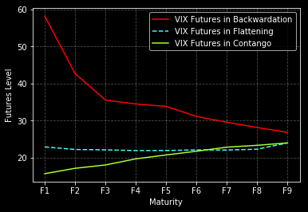
TERM STRUCTURE
CONTANGO
Contango is a situation where the futures price of a commodity is above the expected spot price.
This occurs during less volatile or normal market conditions.
BACKWARDATION
Backwardation is when the current price—spot—price of an underlying asset is higher than prices trading in the futures market.
As market volatility increased, market is in backwardation

Slide 12
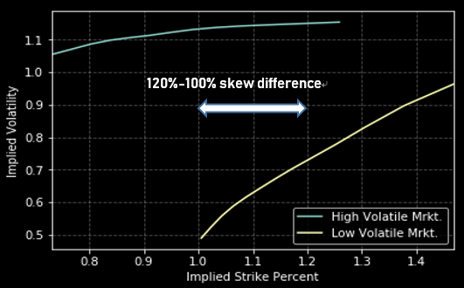
Vol. SUFACE SKEWNESS
Volatility Smile IV Difference :
Different maturities ( '1-mth': 30 days, '2-mth': 60 days, '3-mth': 91 days, '6-mth': 182 days, '9-mth': 273 days, '12-mth': 365 days )
Different VIX Strike price percentage subtraction { ('120.0%', '80.0%'), ('100.0%', '80.0%'), ('120.0%', '100.0%'), ('150.0%', '100.0%') }
Wrong applying Implied-Strike instead of Strike Price
The figure shows that while market is in high volatile, the skewness is much flatter than market in low volatile.
However, we should have an ideal result that shows the skewness while market is in high volatile is much steeper than market in low volatile.

Slide 13
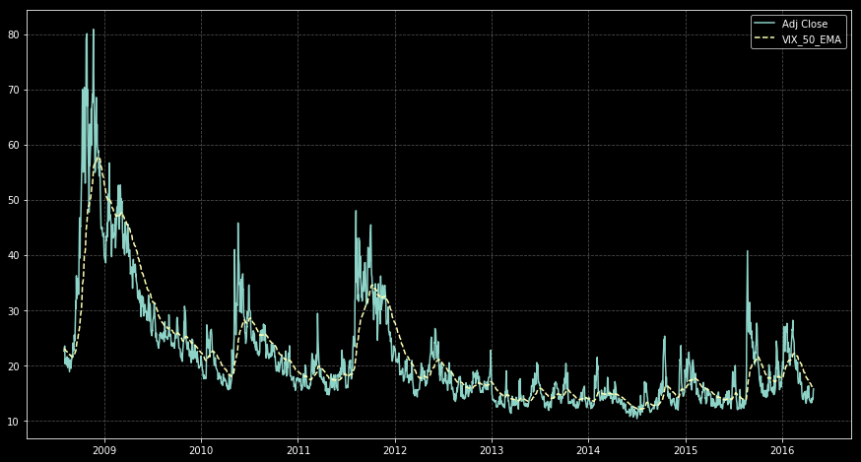
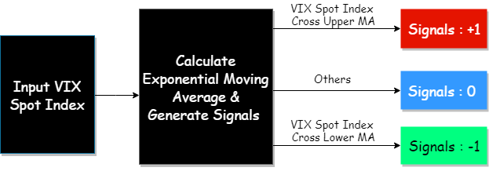
MA Signals & VIX Spot Index

Slide 14

DEEP LEARNING MODEL - LSTM
04

Slide 15

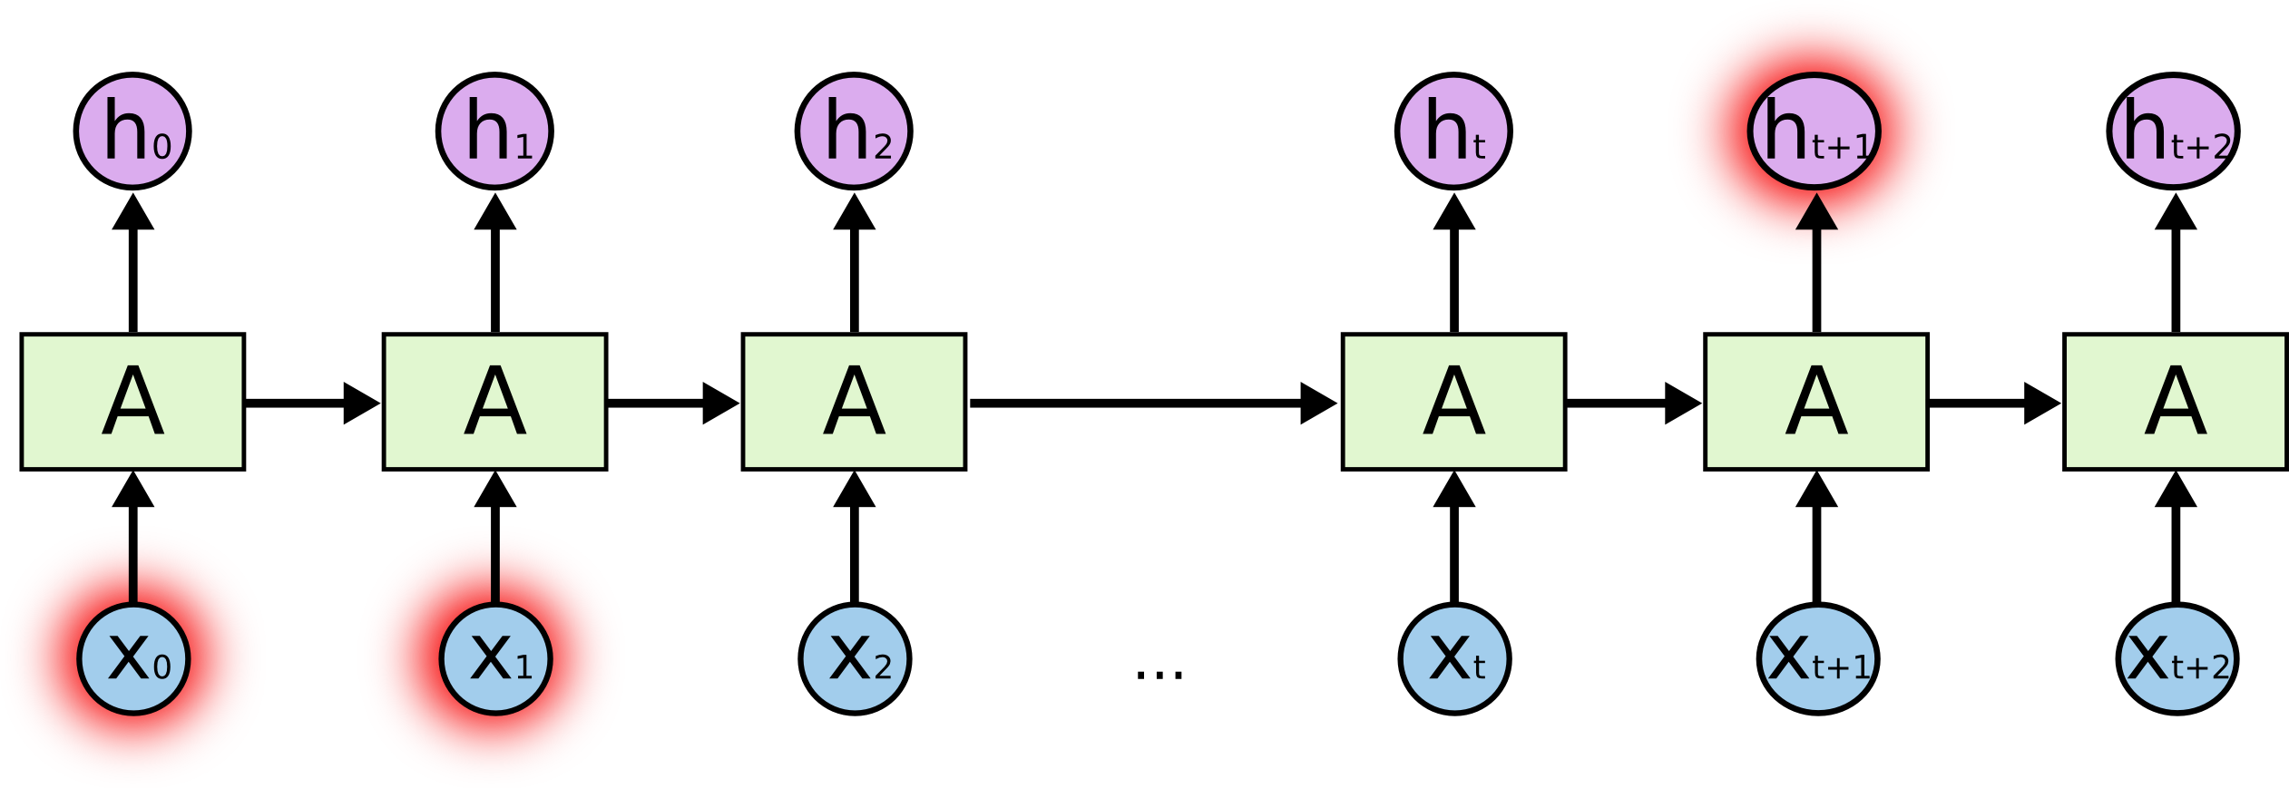
RNN Walkthrough
Unrolled RNN
Short Term Memory Problem

Slide 16



LSTM Networks
Reminder Notation
Conveyor Belt
Forget Gate

Slide 17


LSTM Networks
Reminder Notation
New Memory Cell
Final Memory Cell

Slide 18


LSTM Networks
Reminder Notation
Input Gate
Full Model

Slide 19

05
MODEL RESULT

Slide 20
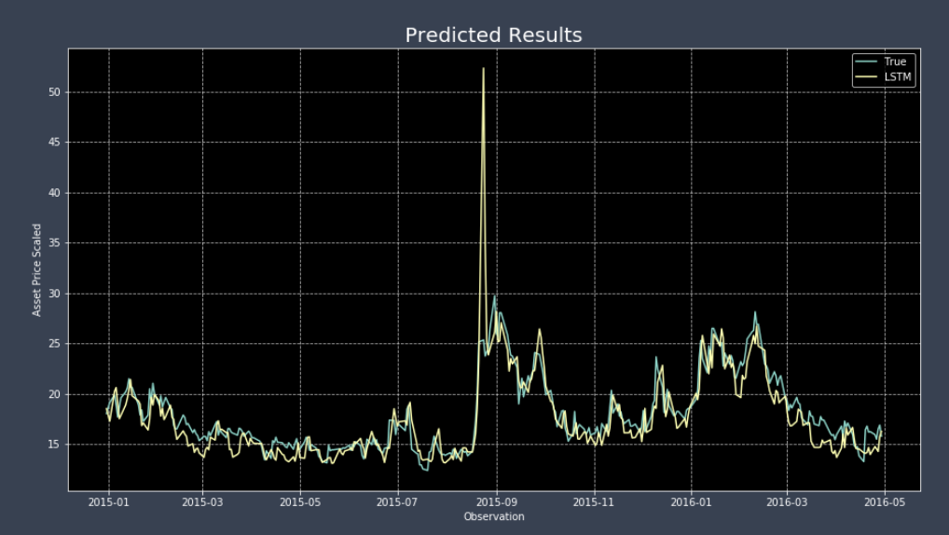
PREDICTED RESULT
Venus has a beautiful name, but it’s terribly hot
Jupiter is a gas giant and the biggest planet in our Solar System
Despite being red, Mars is a cold place, not hot
Saturn is the ringed one and a gas giant

Slide 21

06
Q&A

Slide 22

Thanks for Your Attention !!

